Slide 1

BSSE -Software Quality Engineering
Week-2 Lecture 4
Semester 6- Fall 2020

Slide 2
Quality Engineering – Key SQE Activities – SQE in Software Process
Ms. Zarsha Nazim

Slide 3
Learning Outcomes
Defect Prevention Classification: QA as Dealing with Defects
Education and training
Formal method
Other defect prevention techniques
Software fault tolerance
Defect Reduction Inspection: Direct fault detection and removal Testing
Failure observation and fault removal Other techniques and risk identification
Defect Containment
Safety assurance and failure containment

Slide 4
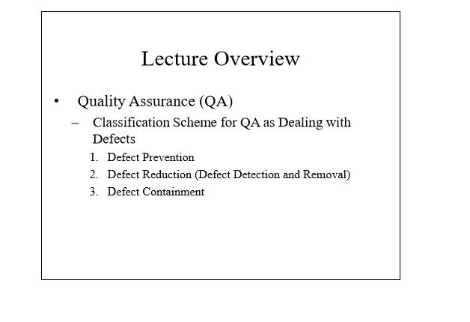

Slide 5
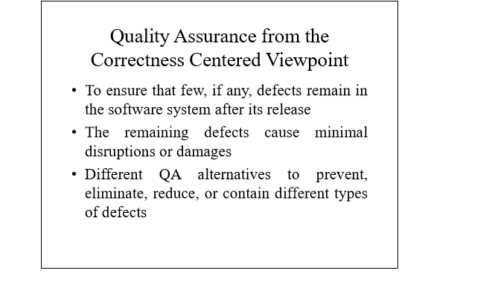

Slide 6
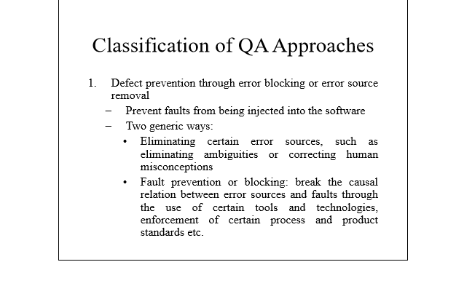

Slide 7
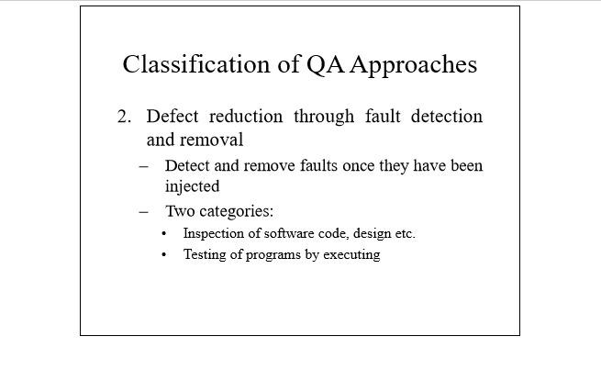

Slide 8
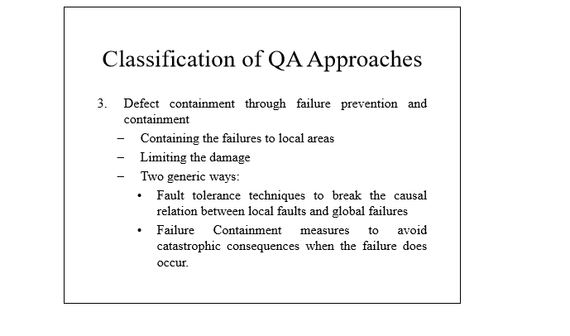

Slide 9
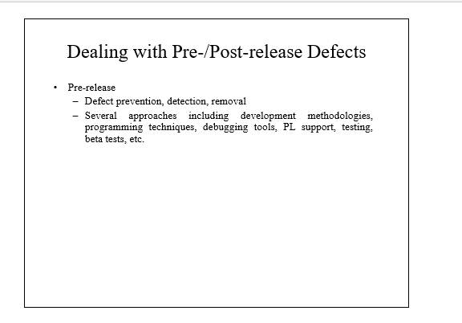

Slide 10
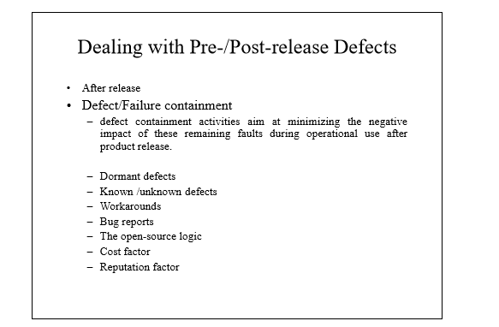

Slide 11
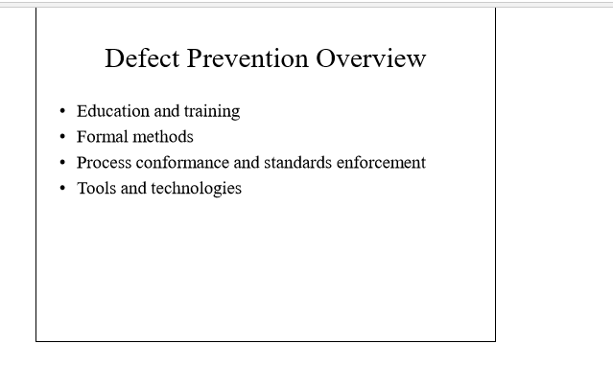

Slide 12
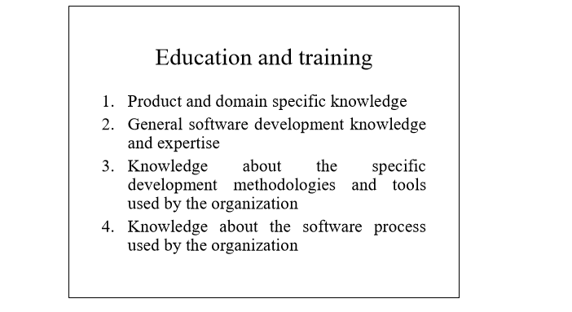

Slide 13
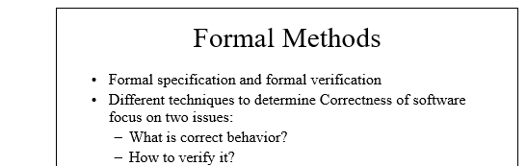

Slide 14
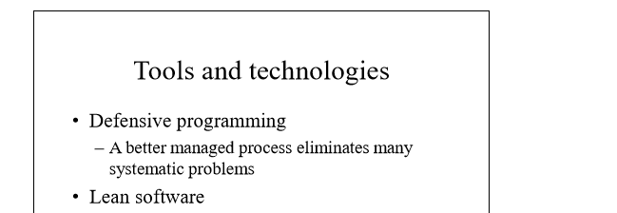

Slide 15
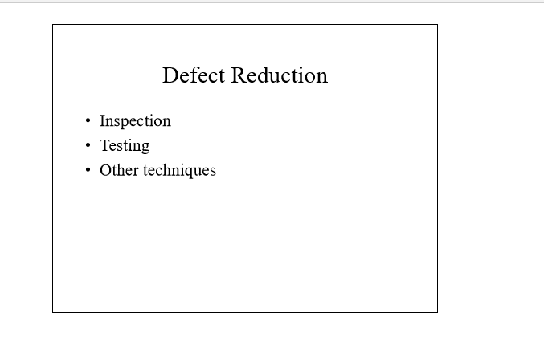

Slide 16
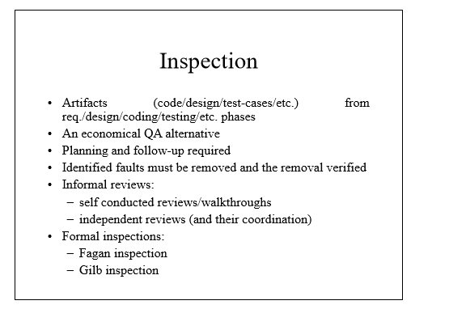

Slide 17
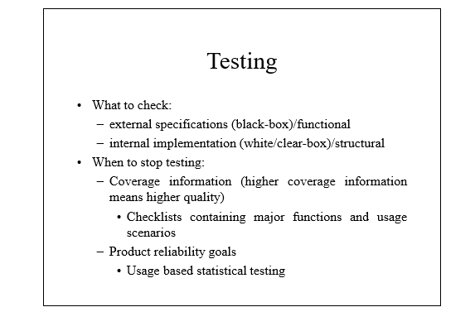

Slide 18
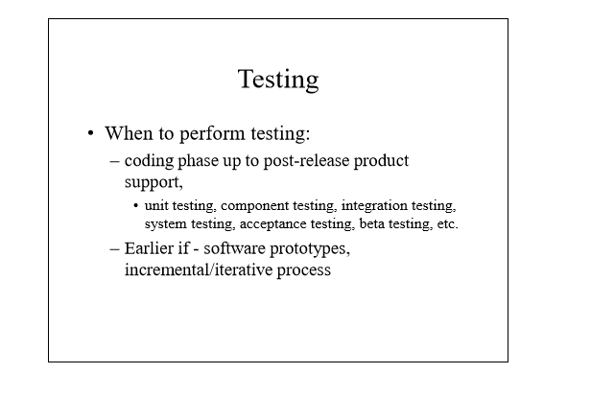

Slide 19
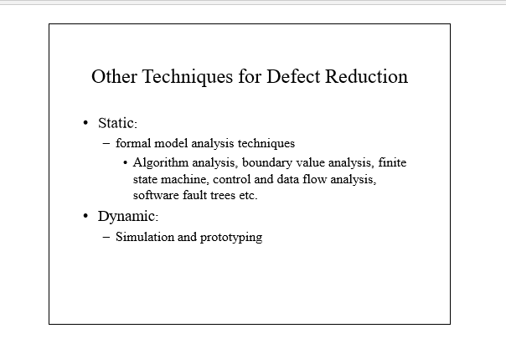

Slide 20
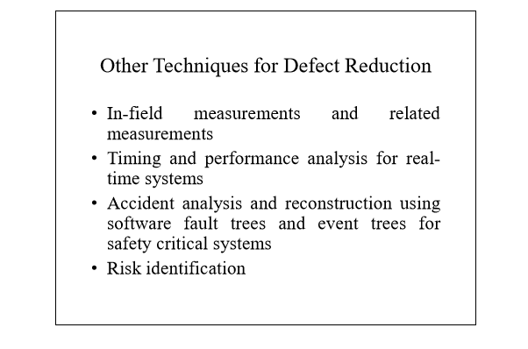

Slide 21
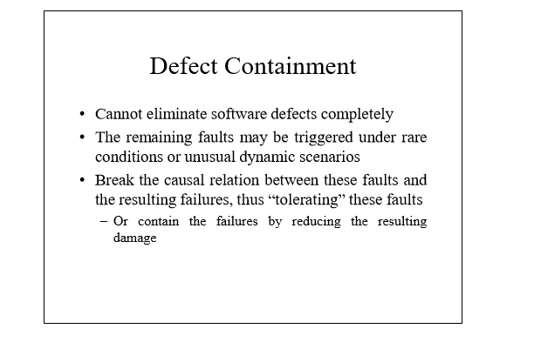

Slide 22


Slide 23
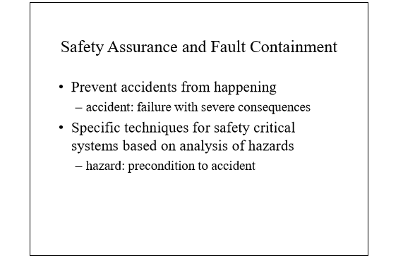

Slide 24
